Slide 1
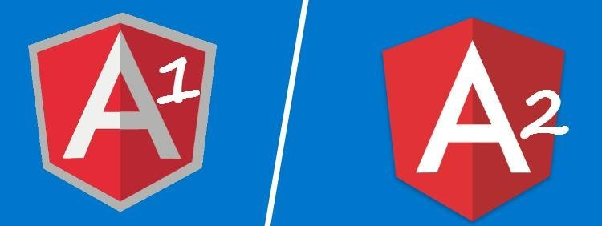
AngularJS
The future of angular

Slide 2
Angularjs vs angular
AngularJS and Angular are two different Frameworks
AngularJS: https://angularjs.org/
Current version: 1.6.3
Angular: https://angular.io/
Current version: 4.0.0

Slide 3
What’s new with angular
TypeScript
TypeScript is a superset of JavaScript that must be transpiled (compiled) into JavaScript
TypeScript is open source, backed by Microsoft
TypeScript add
Annotations
Type checking
Classes & Interfaces
And more…
Angular app can still be written un plain JavaScript, but it is not recommended

Slide 4
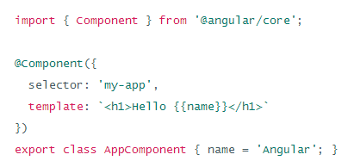
What’s new with angular
Angular syntax is more light and user friendly, more oriented toward functionnality than technique

Slide 5
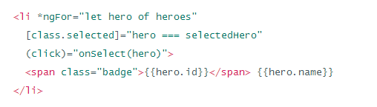
What’s new with angular
Angular syntax is more light and user friendly, more oriented toward functionnality than technique

Slide 6
What’s new with angular
Angular apps run faster than angularjs
Support for Angularjs 1.x will slowly decrease
The team will look at the traffic to both sites, along with GitHub, in order to determine where the community is still invested. This means that if a majority of traffic is still at angularjs.org, the team will continue to focus resources on 1.X. Angular 1.X will not end life until the majority of traffic has moved to 2.0. "We'll continue releasing Angular 1 releases until the vast majority of you migrate to Angular 2

